Slide 1
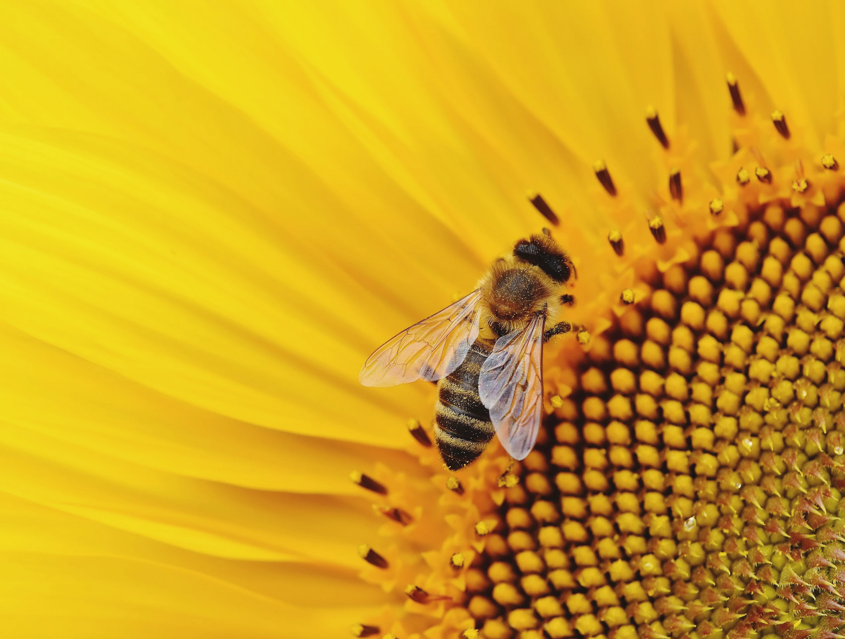


SUPPORTING THE ENVIRONMENT
A 7TH AREA OF FOCUS
Operation Pollination is a simple 7th Area of Focus Environmental Framework — and growing Rotary “Movement “–
that enables and encourages Rotarians to engage in pollinator protection and education projects
DISTRICT 6650 | ROTARY CLUB OF WARREN
ACCESS PRESENTATION ON CANVA
Right click, choose hyperlink and choose open hyperlink

Slide 2

ABOUT OPERATION POLLINATION
  In June 2020, the Rotary International Board of Directors and the Rotary Foundation Trustees added “supporting the environment” as the 7th Area of Focus.
  The Environmental Sustainability Rotary Action Group (ESRAG) provided both the documentation and the leadership in this effort and is a partner in Operation Pollination, embracing the effort as an ESRAG Project.
    This Rotary Action Group operates in accordance with Rotary International policy but is not an agency of or controlled by Rotary International.
    Rotary acts for the environment. ESRAG acts as the catalyst.
    It is not necessary to be a member of a Rotary or Rotaract club to join ESRAG. All are welcome. Anyone who wants to share their expertise to make a positive difference can join the Environmental Sustainability Rotary Action Group. Only Rotarians, Rotaractors, and Rotary Peace Fellows can serve in leadership roles.

Slide 3
ABOUT OPERATION POLLINATION
  Operation Pollination - A Collaborative Rotary Project & A Framework for Success
    It is an inclusive framework to help recruit a diverse array of organizational partners willing to engage in pollinator habitat restoration and education activities.
    ESRAG is a partner of Operation Pollination
    In 2015, federal, state, and local governments, plus numerous for-profit and not-for-profit partners in the St. Croix Valley (MN/WI), collectively supported a Pollinator Resolution that committed participants to take action by “doing something” to protect pollinator habitat. Partners in the project included Rotary District 5960 and its clubs, the National Park Service, the US Forest Service, the US Fish and Wildlife Service, city governments, and many small and large businesses.
  Leveraging the National Park Service's good name, this success story was rebranded as Operation Pollination and has been extended to the large landscapes of National Heritage Areas (NHAs) in the Midwest and elsewhere.

Slide 4
WHY?
The Operation Pollination framework was developed to help us protect the planet for our children and their children.
Pollinators are essential for life on Earth
It is crucial to protect them, but their numbers declined by more than 45% in the past 50 years.
Without pollinators, humans and all of the terrestrial ecosystems could cease to exist.
Pollinator populations are changing. Many pollinator populations are in decline and this decline is attributed most severely to a loss in feeding and nesting habitats. Pollution, the misuse of chemicals, disease, and changes in climatic patterns are all contributing to shrinking and shifting pollinator populations.

Slide 5
WHY?
The Sixth Extinction, in which we’re all living, will be unique in the Earth’s history because it will have been caused by human beings. It’s important to keep in mind that humans, for all their power to change the environment, also have the power to preserve, nurture, and protect.
The way humanity manages or mismanages its nature-based assets, including pollinators, will, in part, define our collective future in the 2nd century.
We are the architects of our own destruction, but we can also be the architects of our own salvation.
The Sixth Extinction: An Unnatural History
Elizabeth Kolbert
UN Environment Programme (UNEP) Executive Director Achim Steiner

Slide 6
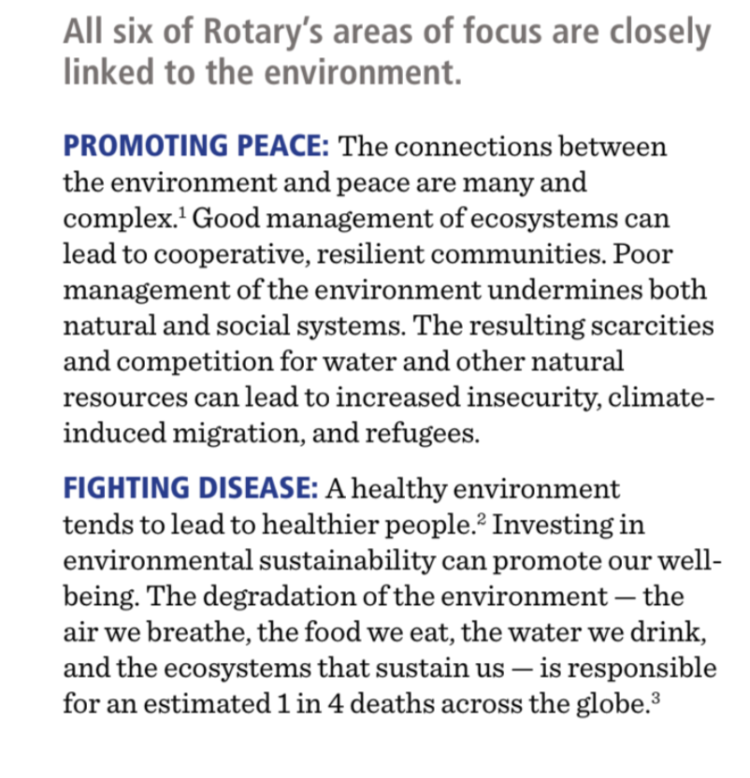
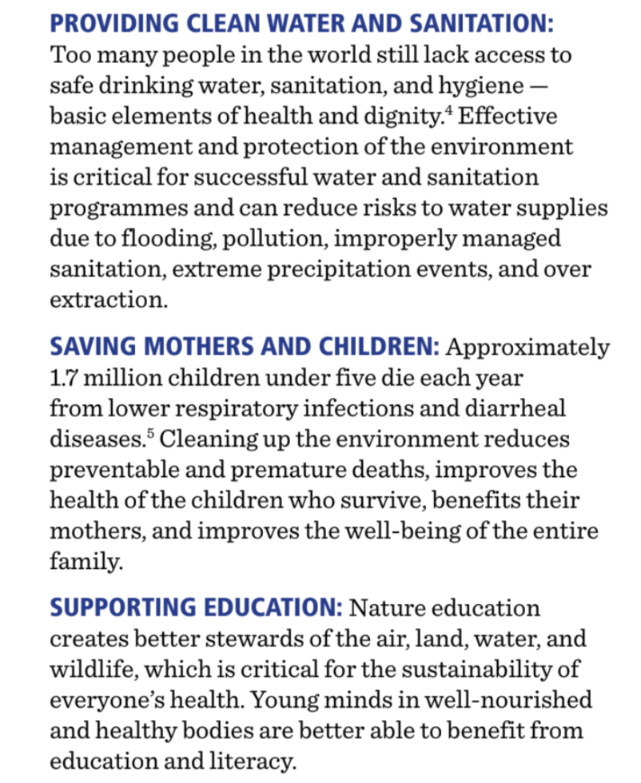
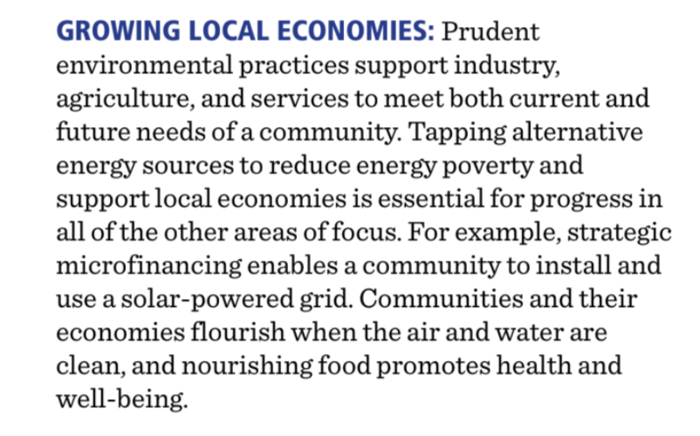
WHY?
IT’S NOT JUST ABOUT THE BIRDS AND BEES
Source: ERSAG

Slide 7
WHY?
THE BEE IS THE PERFECT POLLINATOR TO SERVE AS A SYMBOL
  Almost 90% of wild plants and 75% of leading global crops depend on animal pollination. One out of every three mouthfuls of our food depends on pollinators such as bees. Crops that depend on pollination are five times more valuable than those that do not. They are the most economically important.
  Bees are a cornerstone of our food system, and along with other pollinators, they help support the plants that provide the air we breathe.
  Nearly 90% of flowering plant species on the planet require pollinators to aid in reproduction. This not only provides a food system for wildlife but also creates shelter for animals.
Source: Friends of The Earth
“The bee is more honored than other animals not because she labors,....but because she labors for others”.
Saint John Chrysostom

Slide 8
WHY?
THE BEE IS THE PERFECT POLLINATOR TO SERVE AS A SYMBOL
The fact is that of the 100 crop species
that provide 90 per cent of the world’s food, over 70 are pollinated by bees.”
- Achim Steiner, Executive Director UN Environment Programme (UNEP)
“Human beings have fabricated the illusion that in the 21st century they have the technological prowess to be independent of nature. Bees underline the reality that we are more, not less, dependent on nature’s services in a world of close to 7 billion people”
- Achim Steiner,
Executive Director UN Environment Programme (UNEP)

Slide 9
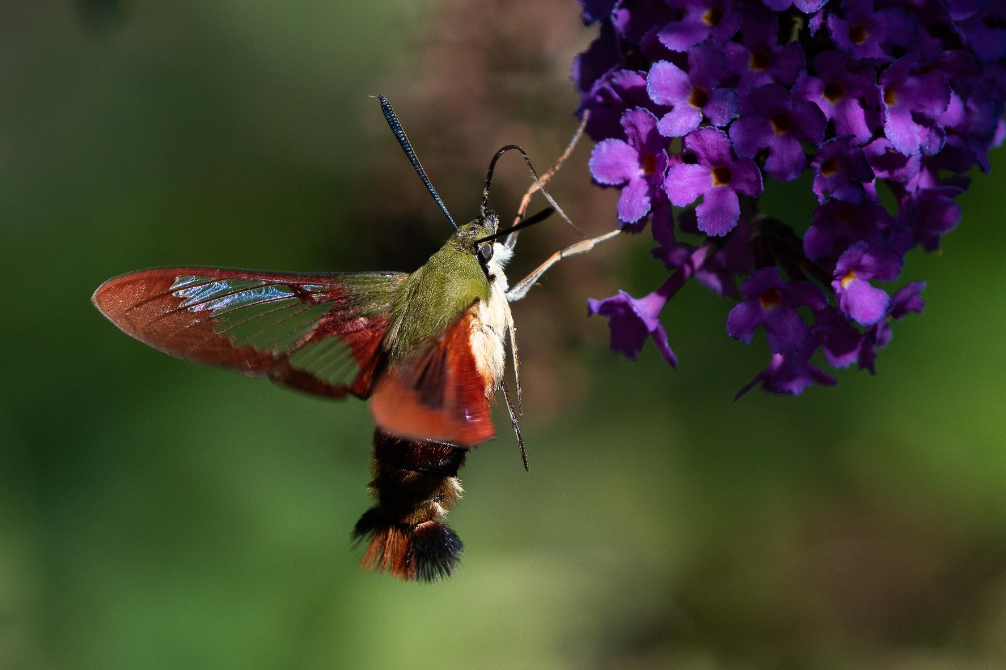
MEET THE OTHER COMMON POLLINATORS
Wasps
Flies
Beetles
Butterflies
Moths
Some birds
Some bats
Source: PNAS
39 studies show that insects other than bees are efficient pollinators providing 39% of visits to crop flowers.
Hummingbird Moth- photographed in a Pollinator’s Garden provided by the Rotary Club of Cortland

Slide 10
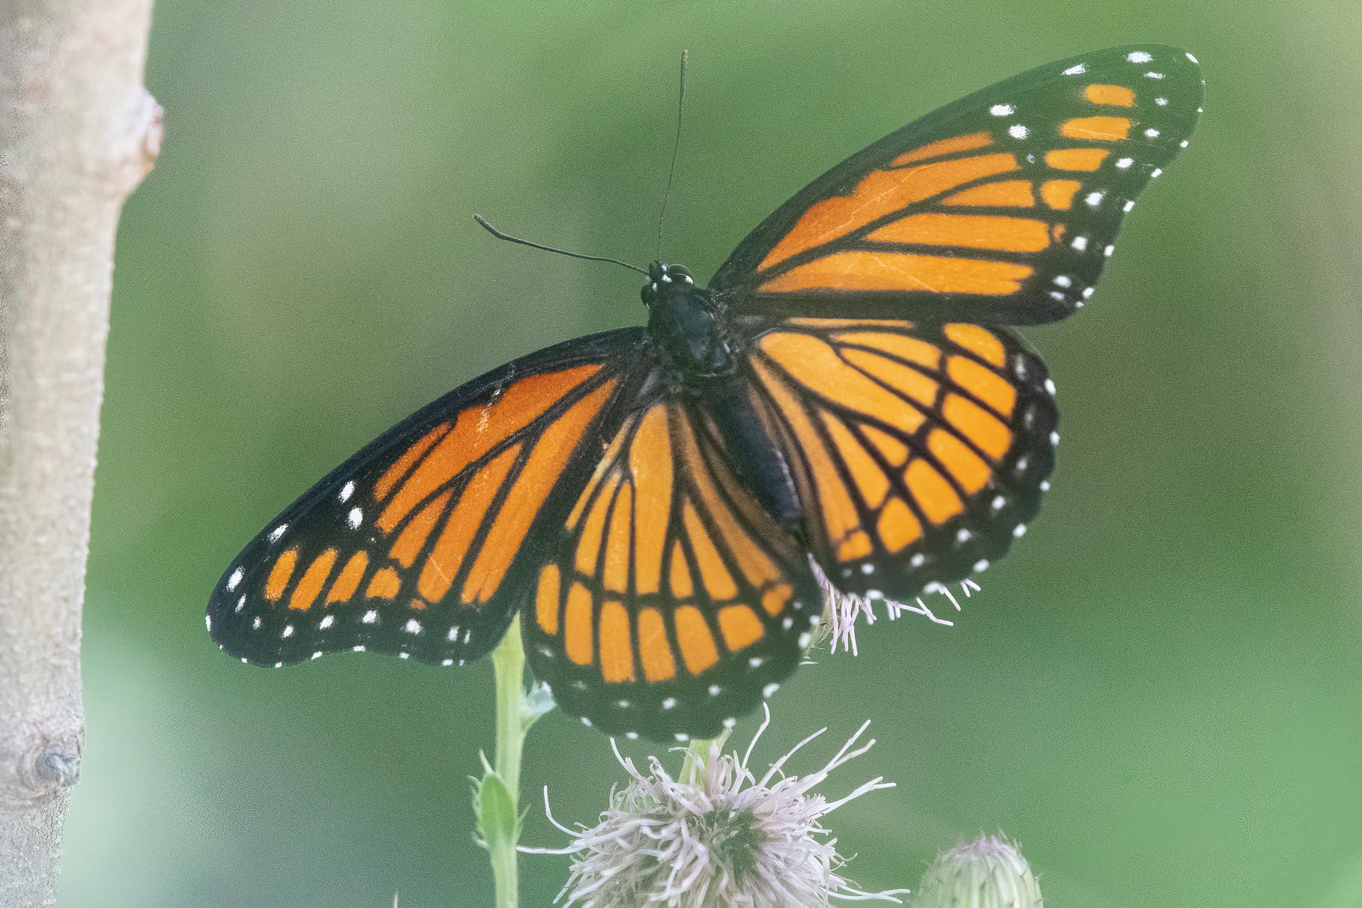
WHAT CAN WE DO?
Ideas
GOALS OF OPERATION POLLINATION
The Goal is to
  Restore pollinator habiat
  Educate people about the importance of pollinators
3. Create a community pollinator garden
4. Encourage members to plant pollinator-friendly plants and trees
Create or participate in an education program, workshop, or event.
5. Learn about the issue and share
Have someone speak at your club about the issue.
6. Raise funds to support habitat restoration.
MONARCH BUTTERFLY- photographed in a Pollinator’s Garden provided by the Rotary Club of Cortland

Slide 11
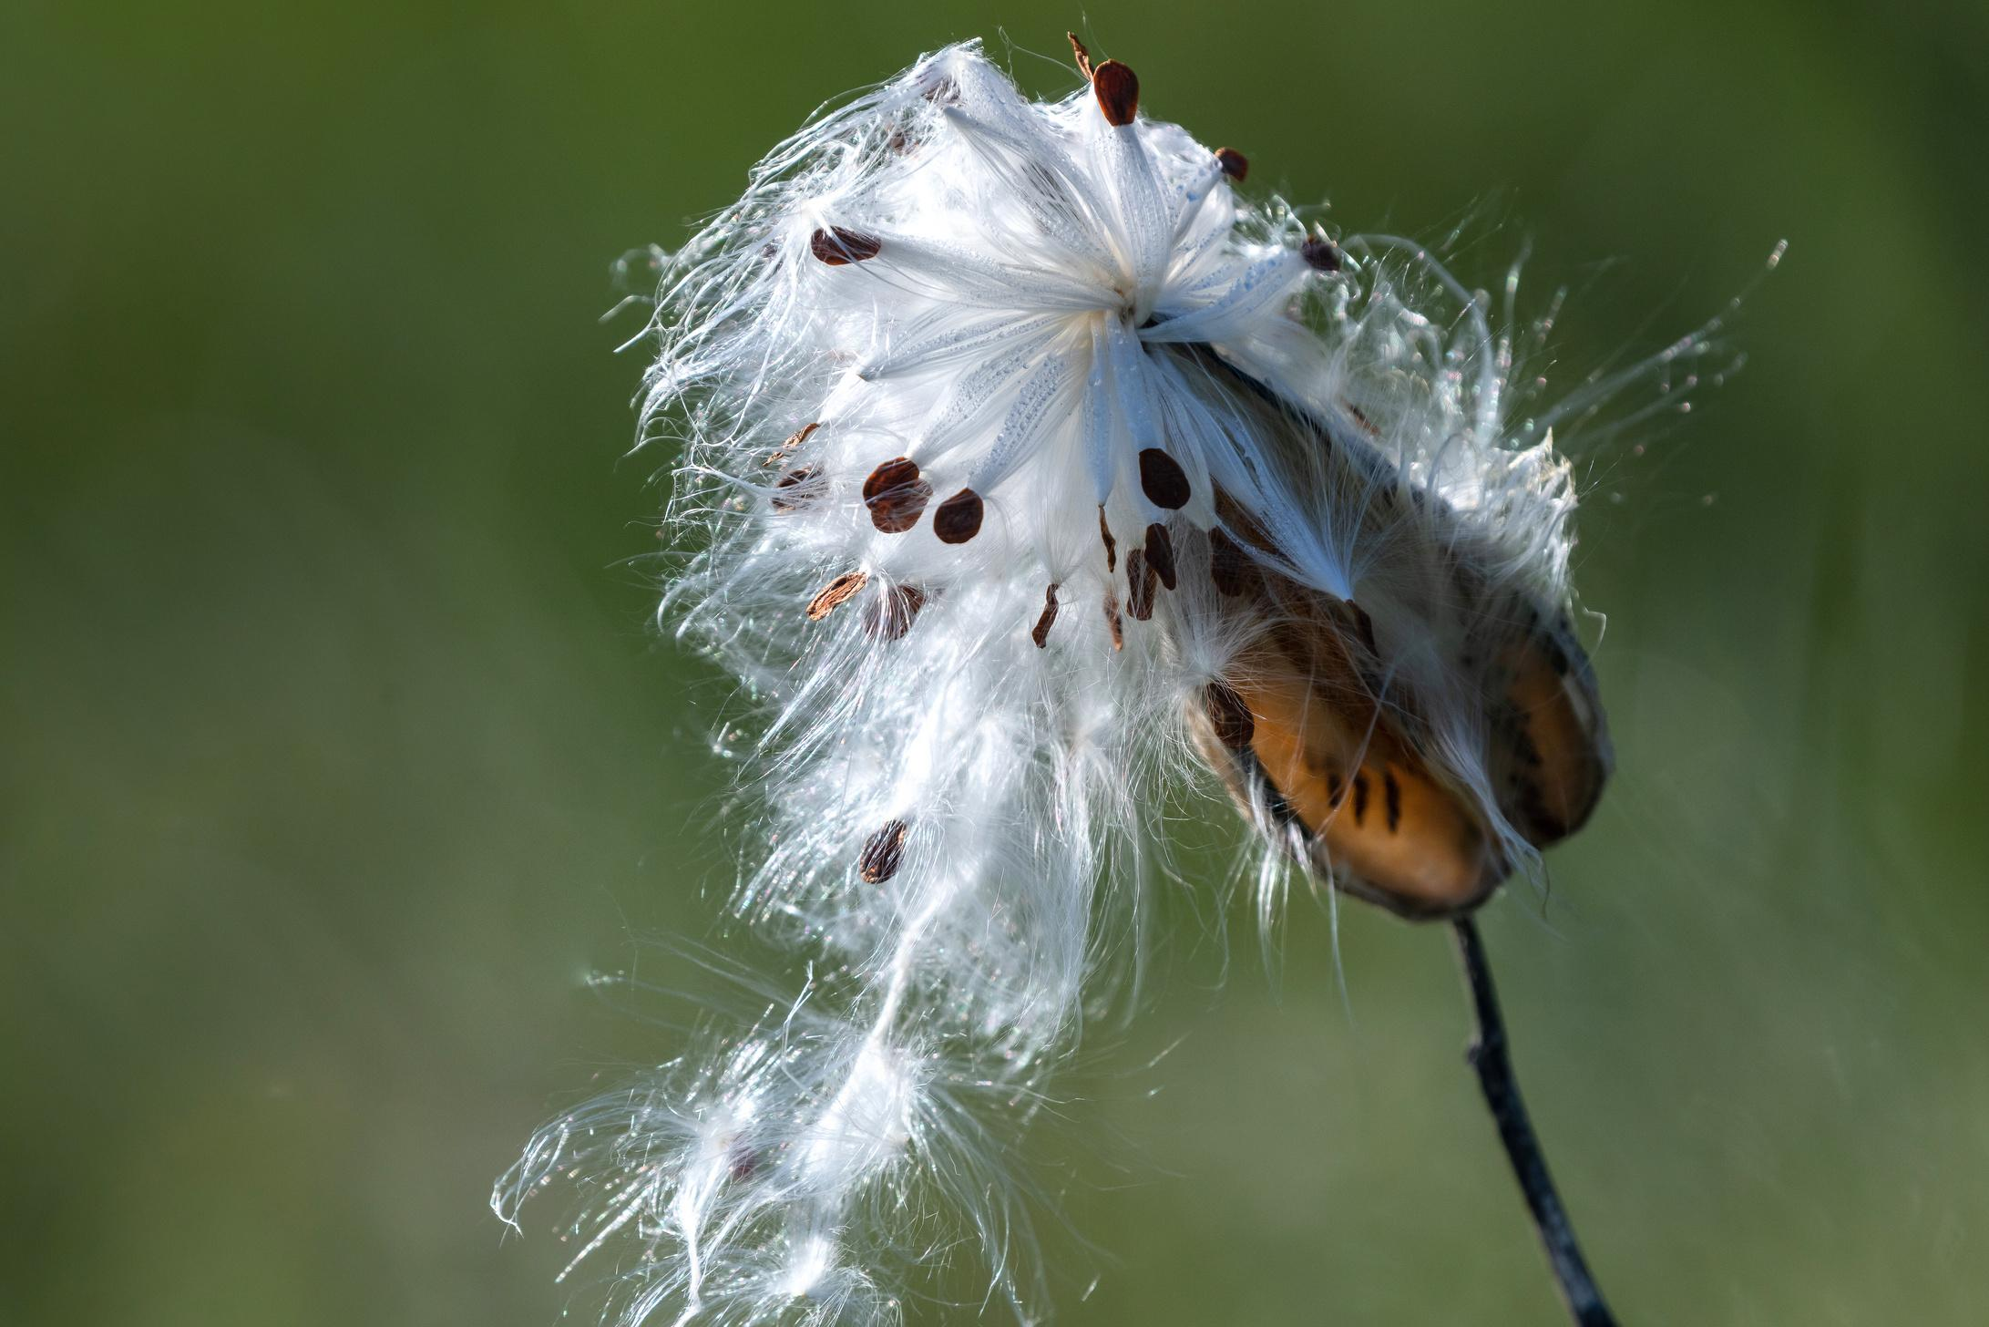
WHAT CAN WE DO?
Grow Milkweed
Common milkweed is Nature's mega food market for insects. Over 450 insects are known to feed on some portion of the plant. Numerous insects are attracted to the nectar-laden flowers and it is not at all uncommon to see flies, beetles, ants, bees, wasps, and butterflies on the flowers at the same time.
COMMON MILKWEED: photographed in a Pollinator’s Garden provided by the Rotary Club of Cortland

Slide 12
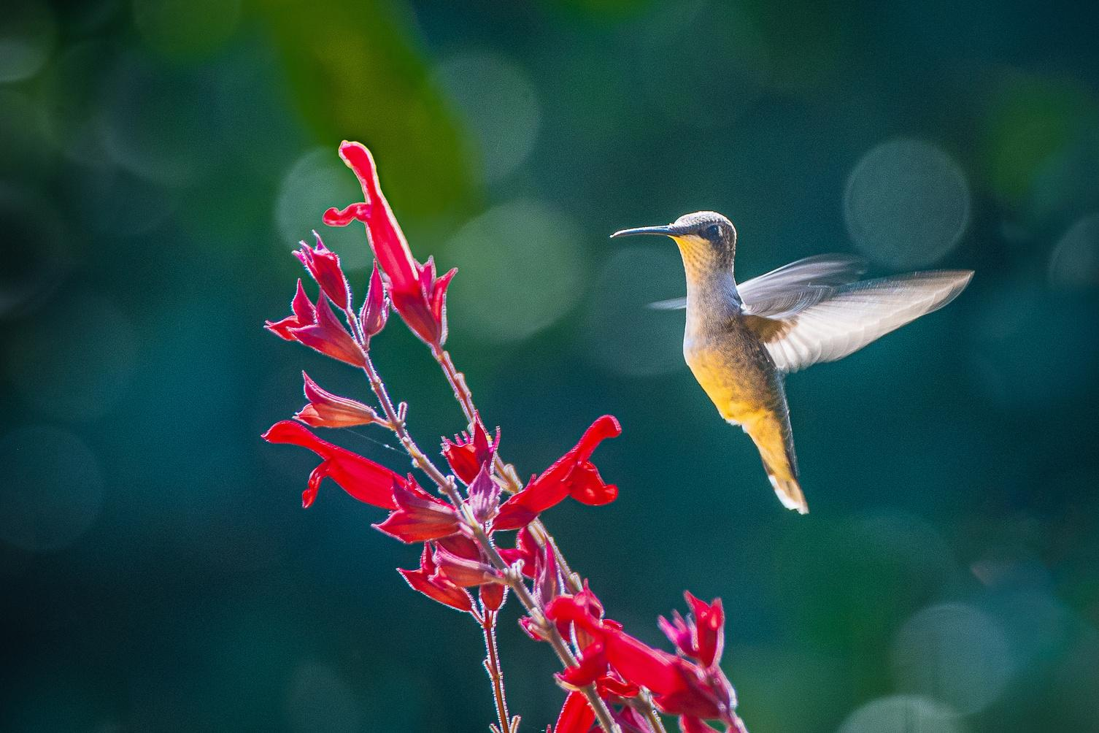
WHAT CAN WE DO?
Grow Awareness
  Share information and highlight club efforts on social media and with local media.
  Purchase an Operation Pollination t-shirt.
  Share on website and in newsletter
  Host an event including highlighting Operation Pollination
  Take lots of pictures!
HUMMINGBIRD - photographed in a Pollinator’s Garden provided by the Rotary Club of Cortland

Slide 13
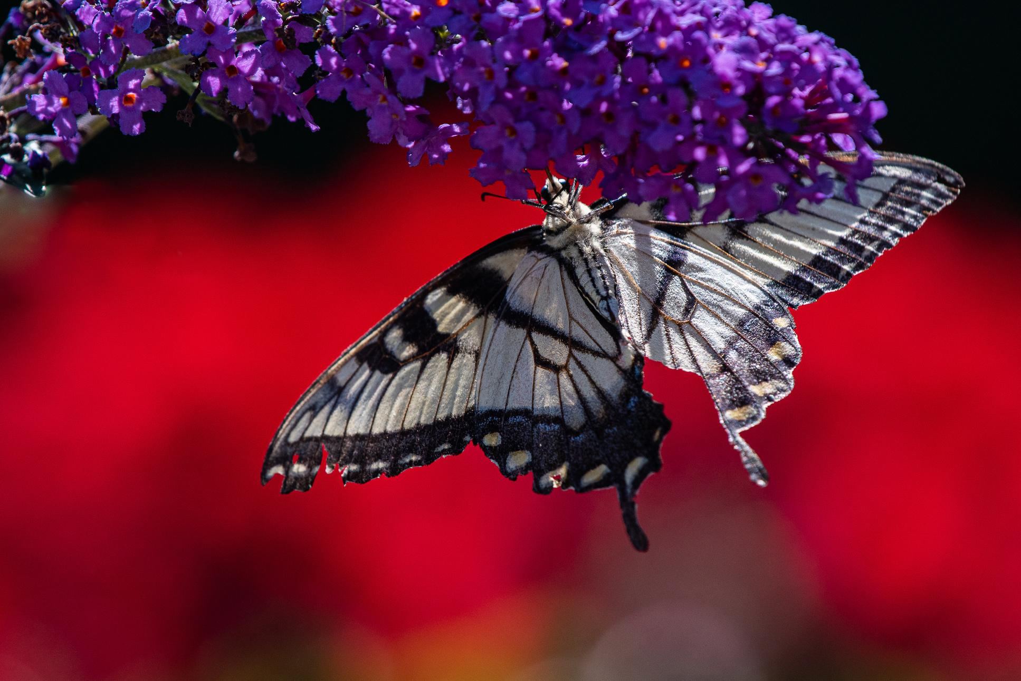
WHAT CAN WE DO?
Spend Time in Nature
The more you connect to nature, the more you will appreciate it, value it, and want to protect it.
When we protect nature, we protect ourselves.

Slide 14
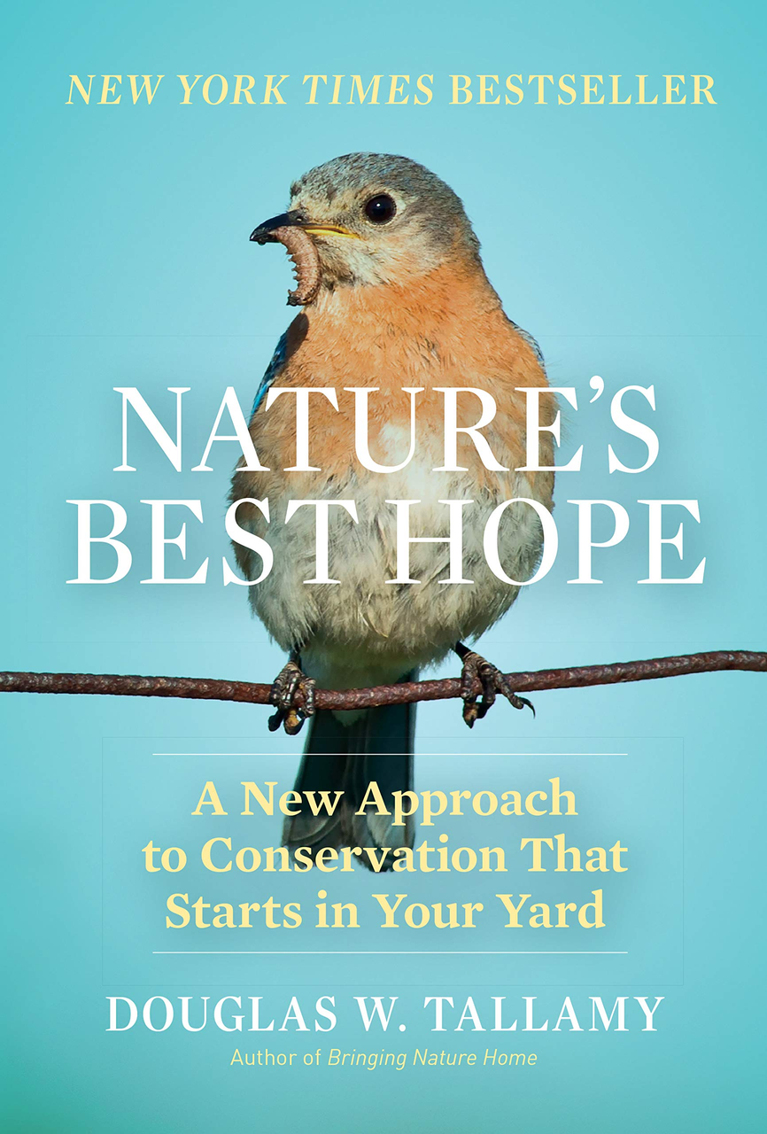

NATURE’S BEST HOPE - A MUST READ
  Wildlife populations are in decline because the native plants they depend on are fast disappearing. The solution? Plant more natives. A grassroots approach to conservation.
  Homeowners everywhere can turn their yards into conservation corridors that provide wildlife habitats.
  This approach relies on the initiatives of private individuals and is immune from the whims of government policy.
I”n the end we will conserve only what we love; we will love only what we understand; and we will understand only what we have been taught”. DOUG TALLAMY
Visit for more info

Slide 15
DISTRICT CHALLENGE
Choose or create action items to support Operation Pollination and protect the future of the planet.
Have fun! There are many easy ways to win points and the district committee encourages you to get involved in any way you can.
Collaboration is encouraged!
Every effort will make a difference. If you don’t see an idea on the suggestion list, contact Christine Cope to ask for the points that will be awarded for your club’s unique project or idea.
The club with the most points will win a $1,000 Paul Harris fellow. If there is a tie, a drawing will be conducted to determine which club will receive the fellow. This a friendly competition. Your participation means we all win!

Slide 16
PLANNING FOR POINTS
Use the provided resources to support your club’s efforts:
  Action item and point list
  Tracking scorecard – tracking is self-reported and on the honor system
  Suggested projects sheet
  List of awareness days in 2024. A new one will be available in 2025.
  Social media posts in Canva
  Planning calendar example with how to plan for your points - in Canva
  Use the Link to this Google Drive folder for additional resources.
  Submit photos to your club-specific Google Drive folder. Bonus points for photos and videos!
BE LIKE A BEE AN LABOR FOR OTHERS
IT’S WHAT ROTARIANS DO

Slide 17
PLANNING FOR POINTS
FIRST STEP
CREATE AN ENVIRONMENTAL COMMITTEE IN YOUR CLUB AND MAKE A PLEDGE TO SUPPORT OPERATION POLLINATION
We can make a difference through the MAGIC OF ROTARY!

Slide 18
LINKS
ERSAG & World Environment Day - A Handbook for Rotary Clubs
Reading for Nature Lovers
Increase Nesting Habitat for Native Bees- Xerces Society
Provides resources and project ideas - The date for World Environment Day changes but the handbook remains valuable.
Operation Pollination
Create a Moon Garden-
for Pollinators
Gardening for Bees and Butterflies
Pollinator Workshop & Quiz
25 Ways to Attract Pollinators
US Fish and Wildlife Service - How to Help Pollinators
Empowering Youth to Save the World - The Pollinator Project
Monarch Watch Waystation Program

Slide 19
LINKS
e-Butterfly
National Park Service - Operation Pollination
A List of Environmental Holidays
How to Build a Better Tree House
OP with Rotary & National Park Services - VIDEO
ERSAG - Operation Pollination
Chris Stein, Chief, National Heritage Areas Midwest Regions,
National Parks Service - VIDEO
Pollinator Activity Pledge
10 Facts About Bees
Pollinator Partnership
DISTRICT 6650 GOOGLE DRIVE RESOURCES

Slide 20
THANK YOU

